Slide 1
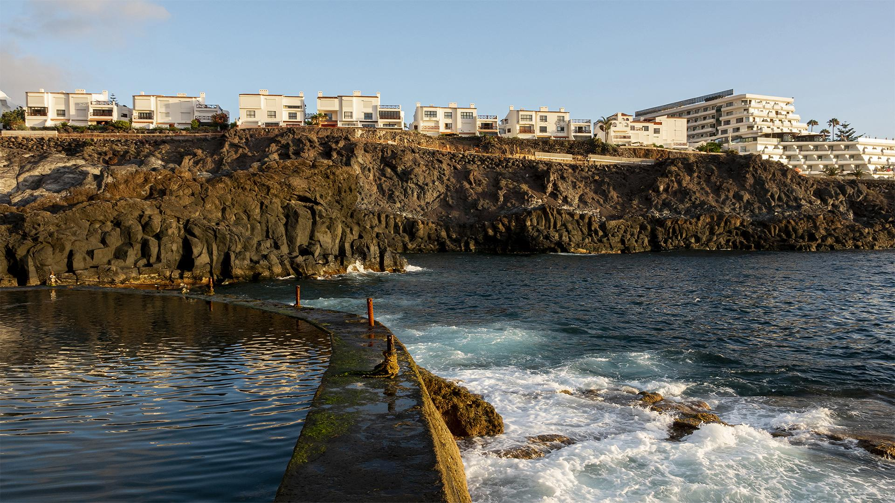
HOTEL RESERVATION ANALYSIS WITH SQL.
Presented By – Piyush Thote
Data Analyst Intern
Batch – MIP-DA-10

Slide 2

TABLE OF CONTENTS
·01·
·02·
·05·
INTRODUCTION
PROBLEM STATEMENT
·03·
DATASET DESCRIPTION
·04·
DATA EXPLORATION AND ANALYSIS
INSIGHTS

Slide 3

·01·
INTRODUCTION

Slide 4

The hostel industry relies on data to make informed decisions and provide a better guest experience.
In this project, I worked with a comprehensive hotel reservation dataset to uncover valuable insights into guest preferences, booking trends, and other key factors that influence hotel operations.

Slide 5

PROBLEM STATEMENT
·02·

Slide 6
I was tasked with analyzing a hotel reservation dataset to uncover critical insights that can enhance the decision-making process and improve the guest experience.
By using SQL to query the dataset,
I had addressed key questions such as the total number of reservations, the most popular meal plans, and booking trends over specific years and months. Additionally, I analysed the most commonly booked room types, weekend reservation patterns, and lead times for bookings. This analysis will explore the distribution of market segments, the total number of adults and children across all reservations, and the average duration of stays. These insights will be instrumental in developing data-driven strategies to optimize hotel operations and enhance guest satisfaction.

Slide 7

·03·
DATASET DESCRIPTION

Slide 8
The dataset used for this analysis provides comprehensive information about the hotel reservations. It includes the following columns:
Booking_ID: A unique identifier for each hotel reservation.
no_of_adults: The number of adults in the reservation.
no_of_children: The number of children in the reservation.
no_of_weekend_nights: The number of nights in the reservation that fall on weekends.
no_of_week_nights: The number of nights in the reservation that fall on weekdays.
type_of_meal_plan: The meal plan chosen by the guests.
room_type_reserved: The type of room reserved by the guests.
lead_time: The number of days between booking and arrival.
arrival_date: The date of arrival.
market_segment_type: The market segment to which the reservation belongs.
avg_price_per_room: The average price per room in the reservation.
booking_status: The status of the booking.

Slide 9
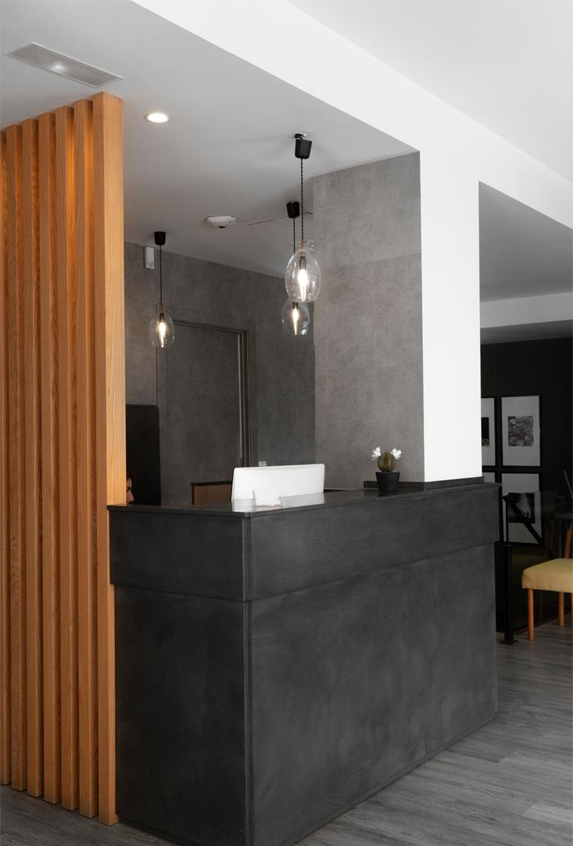
DATA EXPLORATION AND ANALYSIS
·04·

Slide 10
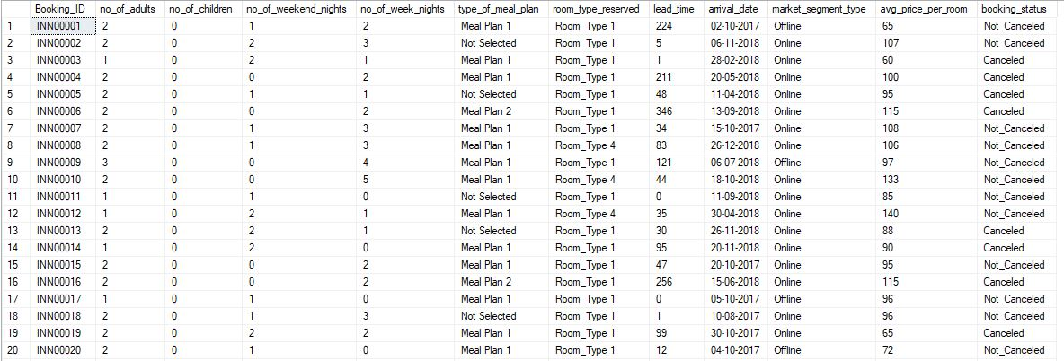
Overview of Dataset

Slide 11
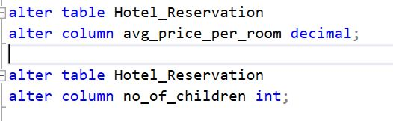
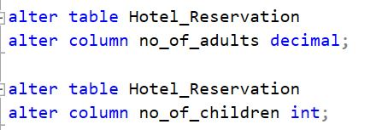
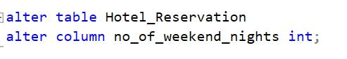
Changing Datatype of Columns

Slide 12
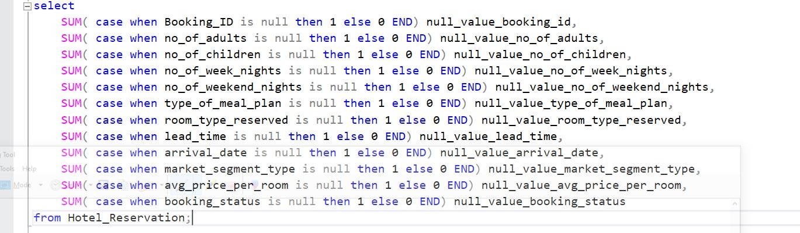
Checking NULL Values in Columns

Slide 13
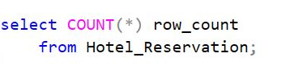
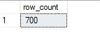
Total Number of Reservations

Slide 14
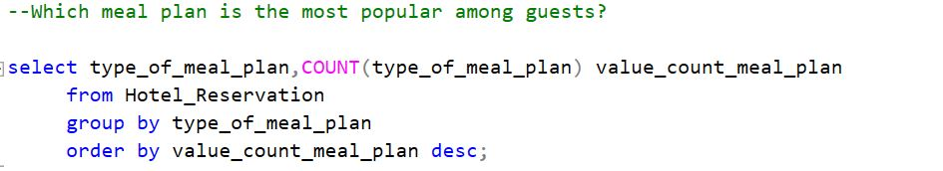
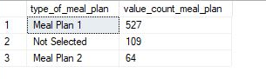
Most popular Meal Plan take During Reservation

Slide 15
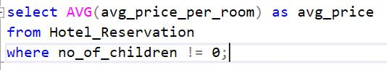
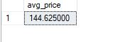
Average price of Room including Children

Slide 16
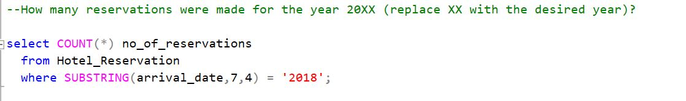
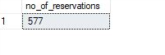
Number of Reservations in Year 2018

Slide 17
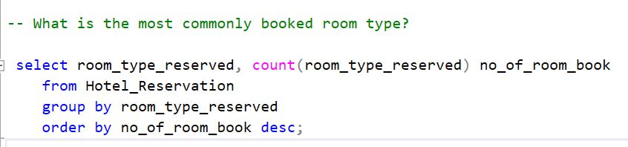
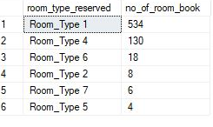
Popular Room booked

Slide 18
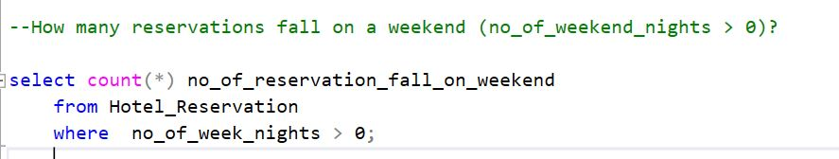
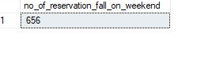
Number of Reservations Done For Weekends

Slide 19
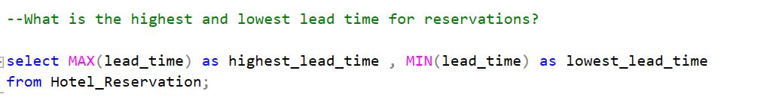
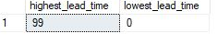
Max and Min Delay in reservation

Slide 20
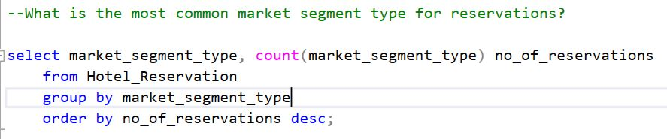
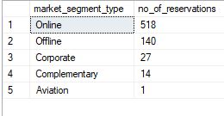
Popular Mode of Reservation

Slide 21
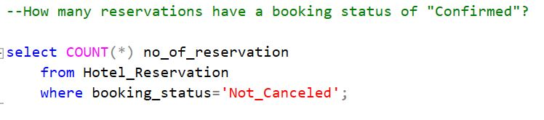
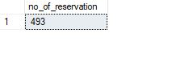
Number of Reservation are confirmed

Slide 22
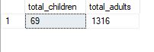
Number of Children and Adult

Slide 23
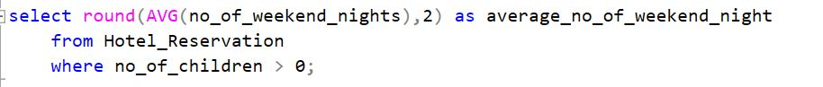
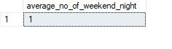
Average number of Weekend Nights Spends

Slide 24
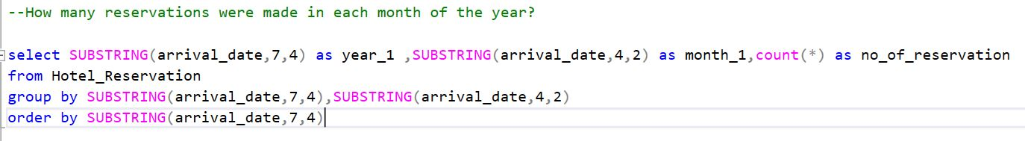
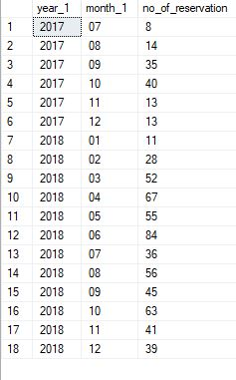
Month wise reservation every Year

Slide 25
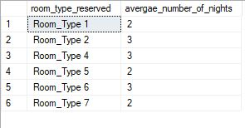
Average night Spend during Week and Weekends

Slide 26
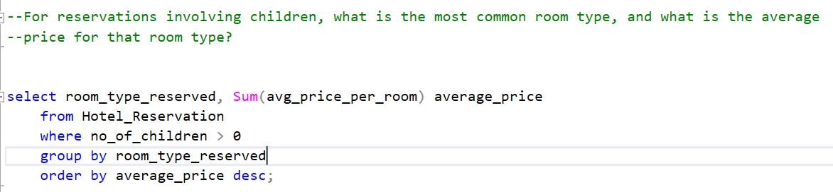
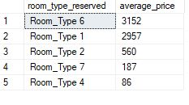
Average Price of Room type

Slide 27
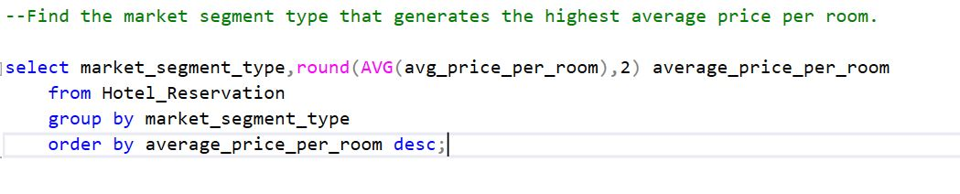
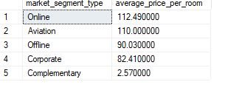
Average Price of Room according To Segment

Slide 28

INSIGHTS
·05·

Slide 29
KEY INSIGHTS
MEAL 1 AND ROOM TYPE 1
·01·
The most popular choices among 700 reservations.
·02·
577 RESERVATIONS
Number of reservation are done in 2018.
ONLINE
·03·
The most popular booking segment among the reservations. .

Slide 30
Rs. 144.57
·04·
The average room price for reservations involving children having lead time 0 to 99.
·05·
1385 GUESTS
Among which 1316 are Adults and 69 are Children.
Rs. 144.49
·06·
The average online booking price which is highest among all booking segments.

Slide 31

THANK YOU

